Slide 1
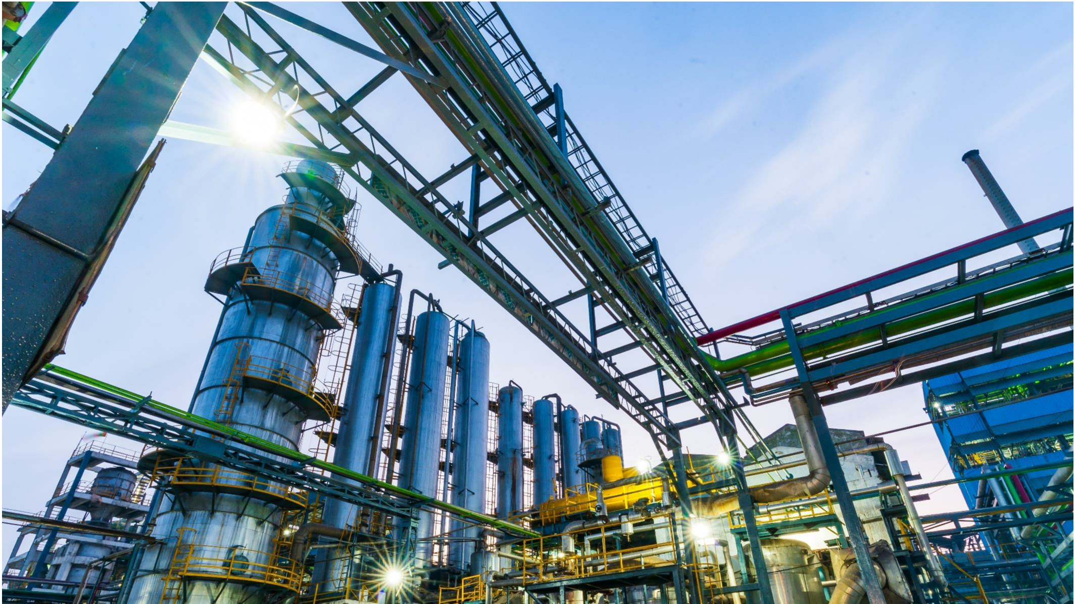
CORPORATE
PRESENTATION
June 2020

Slide 2
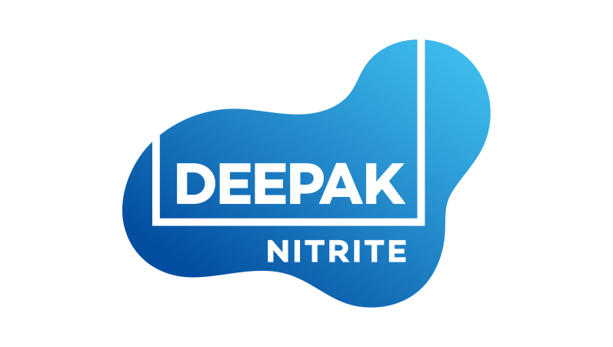
Values
Innovativeness
Driving not just product ideas but also
innovation in terms of processes and employee
engagement thus maximizing growth.
Responsiveness
Towards employees, customers and all
other stakeholders.
VISION-
Ownership
Where the vision becomes not just the
company goal but the individual goal as well.
Vision
Performance driven
Rewarding performers across verticals,
thereby setting examples for leadership.
To become the FASTEST GROWING
Indian chemical intermediates company.
Agility
Change is constant. This equips the organization
to respond rapidly to this dynamic world.
2

Slide 3
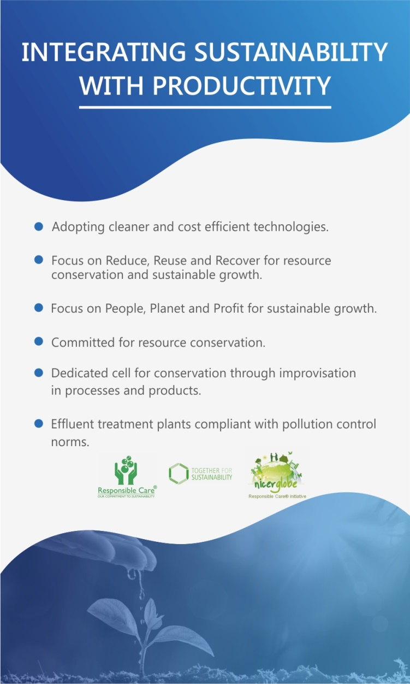
Health & Safety
Focus on plant, process and
people safety.
Emergency preparedness through drills and
pre-tests.
HAZOP studies and safety inspections.
Occupational health centre at each unit.
RESPONSIBLE
CHEMISTRY
Community Care
Community development through
Deepak Foundation
Social interventions spanning over
1,500 villages in Gujarat
Focus areas include:
• Women & Child Welfare
• Integrated Livelihood Promotion
• Disaster Relief
• Rehabilitation & Integrated Child
Development Schemes
ISO 9001, 14001, OHSAS 18001
3

Slide 4
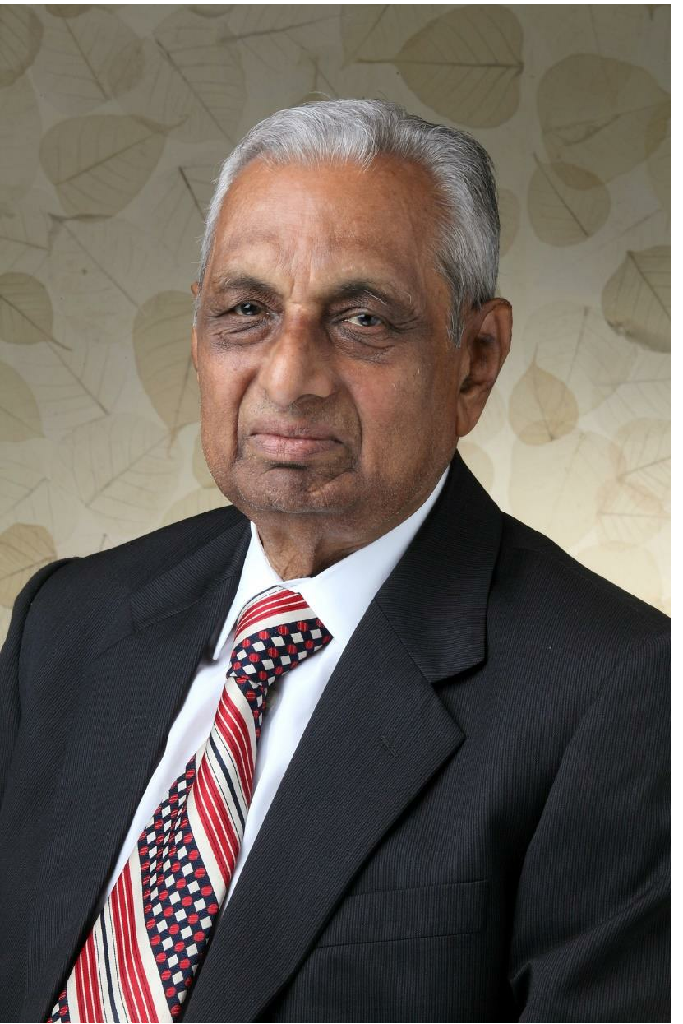
C.K. Mehta
Chairman-Emeritus
Visionary and founder with over five decades of versatile experience in chemical industry.
Credited with leading an able Board and laying the foundation of a strong, professionally driven organisation at par excellence.
An Inspiration to DNL and all group companies, including Deepak Foundation.
Instrumental in initiating company’s CSR initiatives and in establishing Deepak Foundation.
Recipient of ICC Lifetime
Achievement Award in 2014
ABOUT
THE FOUNDER
4

Slide 5
BOARD OF
DIRECTORS AND
LEADERSHIP
TEAM
5

Slide 6
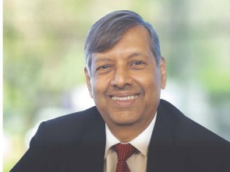
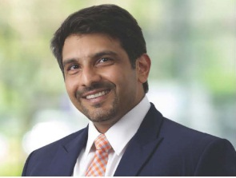
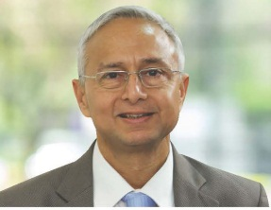
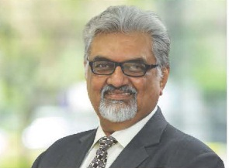
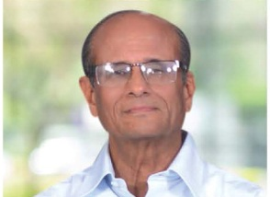
PROFESSIONAL BOARD OF DIRECTORS BACKED BY A
STRONG TEAM
DEEPAK C. MEHTA
MAULIK MEHTA
SANJAY UPADHYAY
Chairman & Managing Director
CEO & Executive Director
Director, Finance & Chief Financial Officer
D. C. Mehta is a dynamic
personality whose business acumen
has enabled the Company to take
swift strides forward and achieve
new laurels, year after year. He is at
the helm of affairs at Deepak Nitrite
for the last 39 years. He is a Science
Graduate from the University of
Bombay.
Maulik D. Mehta holds a Bachelors
degree in Business Administration from University of Liverpool, UK. He has also done Masters in Industrial and Organizational Psychology from Columbia University, USA. He has around 9 years of experience in
the areas of Business Development.
Sanjay Upadhyay is an associate
member of the Institute of Cost
Accountants of India. He is also a Fellow member of the Institute of Company Secretaries of India. He has vast experience in the areas of finance, accounts, commercial and secretarial functions. He is associated with the Company since 1994.
AJAY C. MEHTA
SUDHIR MANKAD
Non Executive Director
Independent Director
A. C. Mehta has been actively
associated with the Company since 1984. With extensive experience,
a comprehensive approach and strong industry foresight, he has paved the way for innovation and excellence in the Company.
Sudhir Mankad, IAS (Retd.), has
served in senior positions, both with
the Government of India and the
Government of Gujarat. His last
assignment was Chief Secretary,
Government of Gujarat. He has
served as a Director/Chairman on
the Board of several companies.
6

Slide 7
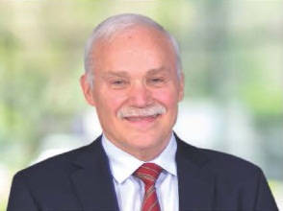
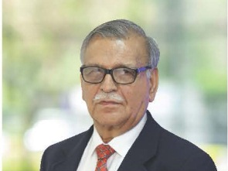
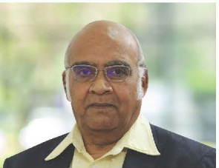
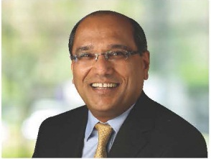
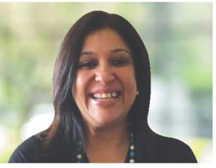
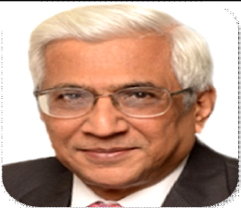
PROFESSIONAL BOARD OF DIRECTORS BACKED BY A
STRONG TEAM
Dr. RICHARD H. RUPP
S. K. ANAND
Dr. S. SIVARAM
Independent
Director
Independent
Director
Independent Director
Richared Rupp held various positions in leading multinational
companies such as Hoechst AG
(Germany), Lonza (Switzerland) and
Allessachemie (Germany). His focus is
in the field of pharmaceuticals and
fine chemicals.
S. K. Anand has a rich experience
of around 45 years in the field of
Project Management, Operations,
Corporate Planning, Quality
Management, Health, Safety and
Environment Management, Energy
Management and Strategic Planning
in petrochemicals, refining and other
allied industries.
Sivaram is a scientist of distinction,
having held leadership positions in R&D, in both industry and academia. He has done his M.Sc. from the Indian Institute of Technology, Kanpur, and Ph.D. from Purdue University, W. Lafayette, Indiana, USA.
SANJAY ASHER
PURVI SETH
DILEEP CHOKSI
Independent
Director
Independent Director
Additional Director
Sanjay Asher has been a practising advocate since 1991, and was admitted as a solicitor in 1993. A qualified Chartered Accountant, he specialises in the fields of corporate and commercial law, corss-border M&A, joint ventures, and capital markets, and advises large, medium and small business enterprises on these subjects.
Purvi Seth helps create business opportunities and competitive advantage via Strategic HR management. She has helped several businesses effectively cultivate talent engagement through advanced leadership processes and implementation in impacting business performance and productivity.
Mr. Dileep C. Choksi is a chartered accountant and has experience over 40 years. His areas of specialization include business succession, tax advisory & litigation, structuring of collaborations & joint ventures, corporate restructuring, turnaround & change management strategies. Mr. Choksi was the former Joint Managing Partner of Deloitte in India till 2008, before the setting up of C.C. Chokshi Advisors Pvt. Ltd. of which he is the Chief Mentor.
7

Slide 8
HISTORY
2013
Brownfield expansion for manufacturing
Sodium Nitrite & Nitrate at Nandesari Turnover crosses INR 1,000 crore
2015
Promoted Deepak
Phenolics Limited for
manufacturing of Phenol & Acetone
2017
Raised INR 150 crore
via QIP (2nd Round)
to fund the phenol project
1972
Commissioned
Sodium Nitrite &
Nitrate Plant at Vadodara, Gujarat
1992
Commissioned
Nitro Aromatic
Plant at Nandesari
2003
Acquisition of
management and
control of Aryan
Pesticides Limited
1970
Incorporation of Deepak Nitrite Limited
2010
Foray into Fuel
Additives business
1971
Listed on BSE
with landmark
over-subscription
1984
Acquisition of
Sahyadri Dyestuffs
& Chemicals unit
from Mafatlal
Industries
1995
Commissioned a
full fledged
Hydrogenation
Plant at Taloja
2007
Acquisition of
DASDA Division
from Vasant
Chemicals at
Telangana
2012
Accredited with
‘Responsible care'- a global benchmark of environment, safety and health management
2014
Commissioned a world-class facility to manufacture Optical Brightening Agents (OBA)
2016
Raised INR 83 crore via QIP (1st Round) to fund the phenol project
2020
Deepak Phenolics commissioned IPA Plant (Iso-propyl alcohol).
8

Slide 9
Net
Revenue
3208 Cr.
Leading
producer
Largest
producer
of Phenol & Acetone since 2018 in India
of Sodium Nitrite
and Sodium Nitrate
since 1972 in India
COMPANY
OVERVIEW
FY19-20
(Consolidated)
Amongst top
3 global
players
6
Exports
Since 1972, Deepak Nitrite has been
a leading intermediates company in
the Indian chemical industry.
We serve numerous industries & 56
applications with a portfolio of
over 100 international quality
products.
We are a recognized globally as a
‘Responsible Manufacturer’ and as a ‘Supplier of Choice’ by our clients.
Manufacturing
Facilities
to 30 countries,
6 continents
for products like
Xylidines, Cumidines
and Oximes
50 years
IPA Production
Legacy
For Pharma and Sanitizer
9

Slide 10
30
6
56+
Countries
Continents
Applications
GLOBAL REACH
1000+
100+
Customers
Products
10

Slide 11
Product Portfolio:
Applications
Basic Chemicals
Fine & Specialty Chemicals
Performance Products
Pharmaceuticals
Agrochemicals
Resins
Supplier of Choice for :
MAJOR CUSTOMERS
Personal Care
Petrochemicals
Adhesives
Dyes and Pigments
Paper
Coatings
Fuel Additives
Detergents
Adol Chemicals
11

Slide 12
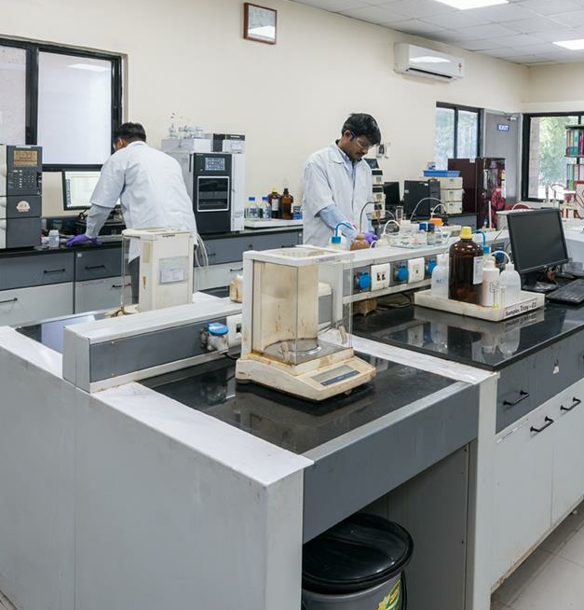
ISO 9001, 14001, OHSAS 18001
DSIR Approved
Strong team of 70 scientists
Novel chemistries developed and commercialized for
global consumption
Cost-effective and eco-friendly process development
Chemical synthesis for different product segments
Deepak Research and Development Center (DRDC)
Advanced Intermediate developed & commercialized
For MNCs
Fields of Expertise:
Advanced sulphonation
Multiple pathway oxidation
Continuous reduction nanotechnology
Ion-exchange resins
Location: Nandesari, Gujarat, India
Facilities
State-of-the-art
Instruments and Equipment
• HPLCs and GCs
• FTIR
• UV-visible spectrophotometer
• Micro reactor
• Wiped film evaporator
• Vapour phase fixed bed reactors
• Autoclaves of various capacities and MOCs
• Horizontal beadmill
• Rotary furnace
• Multiple CSTR assembly
• Nanofiltration setup
Expertise in multiple chemical processes
Nitration I Catalytic hydrogenation I Sulphonation
Oxidation I Oxidative Coupling I Alkylayion ( C, N & O)
Dissolving metal Reduction I Diazotization I Lithiation
Ammonidation I Halogenation I C-C ( Grignard, Suzuki, Heck etc) | Enzyme catalysis
12

Slide 13
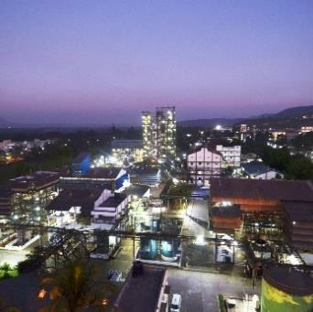
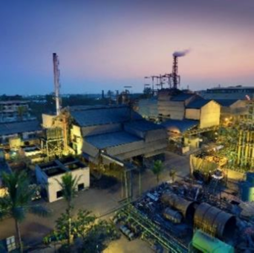
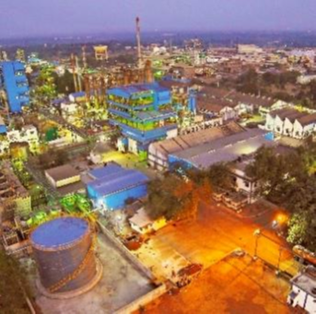
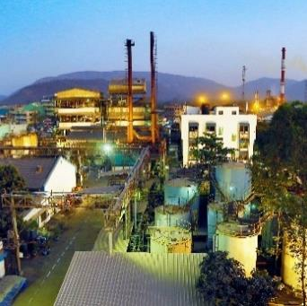
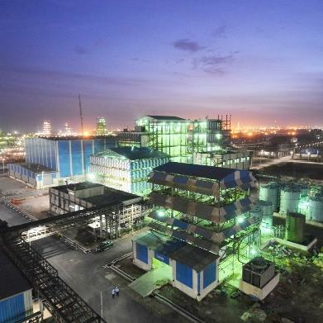
MANUFACTURING FACILITIES
Nandesari
Taloja
Dahej
The first and flagship
manufacturing facility.
Synthetic Organic
chemicals, Fine and
Specialty chemicals
Basic chemicals, Fine and
Specialty chemicals,
Performance products,
Phenol and Acetone
Inorganic and organic
chemicals,
Agro Chemicals
Fully automatic batch
process
Roha
Hyderabad
Intermediates for
Agrochemicals, Dyes,
Fine and Specialty
chemicals.
Dye Intermediates
13

Slide 14
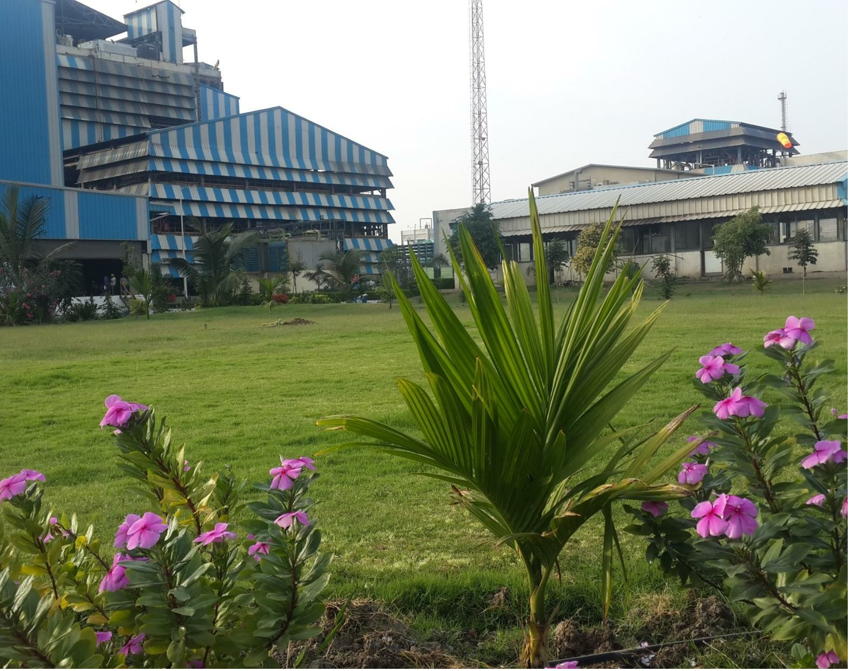
Green Belt
110702 Sq. Mt
ECO-CONSCIOUS
14

Slide 15
• Sodium Nitrite
Sodium Nitrate
Nitro Toluidines
Fuel Additives
Nitrosyl Sulphuric Acid
BUSINESS
Colourants
Petrochemicals
Rubber
SEGMENTS
BASIC CHEMICALS
(BCC)
42% of
▪ High volume segment consisting - Bulk
Chemicals & Commodities made to standard
specifications.
Total Revenues in FY19
Organic chemicals
Inorganic chemicals
Fuel additives
42%
15

Slide 16
BASIC CHEMICALS CUSTOMERS
16

Slide 17
• Xylidines
• Oximes
Agrochemicals
Colors & Pigments
Paper
• Cumidines
• Specialty agrochemicals
BUSINESS
SEGMENTS
29% of
Personal Care
Pharmaceuticals
FINE AND SPECIALTY
Total Revenues in FY19
• Includes niche products that require greater
value addition.
• Segregated into Specialty Chemicals,
Xylidines, Oximes, Cumidines, Nitro Xylene
amongst others.
• Products customized as per customer
specifications.
• Application in the manufacture of agrochemicals, colour & pigments, paper, personal care, pharmaceuticals etc.
CHEMICALS
29%
17

Slide 18
FINE & SPECIALTY CUSTOMERS
18

Slide 19
Optical Brightening Agent
(OBA)
Flavonic Acid
BUSINESS
29% of
SEGMENTS
Total Revenues in FY19
PERFORMANCE
Florescent Whitening Agent (FWA) is an application chemical; commonly known as Optical Brightening Agent (OBA).
Fully integrated manufacturer of FWA, startup from Toluene as basic building block
Wide applications across Paper, Detergents, Textiles, Coating Applications in Printing & Photographic Paper
Customized into liquid or powdered form, as per the customer’s requirements.
PRODUCTS
29%
19

Slide 20
OPTICAL
BRIGHTNING
AGENTS
CUSTOMERS
20

Slide 21
21

Slide 22
Delivering our promises
Making India self-reliant in production of Phenol and Acetone
Reducing India’s import dependence on chemical intermediates
Taking care of India’s demand-supply gap in Phenol and Acetone
At full capacity, plant is projected to result in import savings of around USD 400 Million
Plant commissioned within time
Plant stabilised and touched 100% capacity utilisation within a short span of time
Reported positive EBITDA and Profit Before Tax within few months of commissioning
Created robust supply chain infrastructure and logistics
Driving our goal of being the fastest-growing Indian chemical intermediates manufacturer
22

Slide 23
PHENOL, ACETONE DOMESTIC PRODUCTION
23

Slide 24
Manufacturing Capacity
200 KTPA Total manufacturing capacity for Phenol
120 KTPA Total manufacturing capacity for Acetone
260 KTPA Total manufacturing capacity for Cumene
30 KTPA Total manufacturing capacity for Iso-Propyl Alcohol
PHENOL &ACETONE FACILITY AT DAHEJ - SNAPSHOT
Technology Tie-ups
Technology tie-up with UOP Honeywell
Technology tie-up with KBR (USA
KBR is a licensor of phenol capacity
Badger, USA for IPA
24

Slide 25
FINANCIALS
25

Slide 26
Financial Summary
(Consolidated YTD
Mar-20)
Financial Summary
(Consolidated YTD
Mar-19)
4265
2715
Net Revenue
Net Revenue
FINANCIAL
SUMMARY
1061
429
EBITDA
EBITDA
611
174
PAT
PAT
*Figures in Crore
26

Slide 27
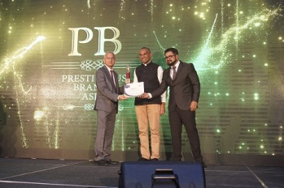
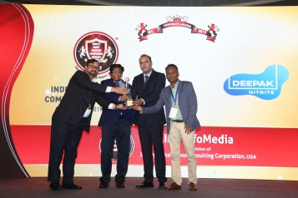
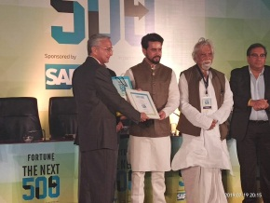
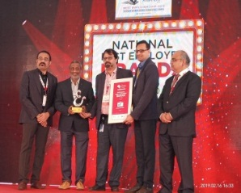
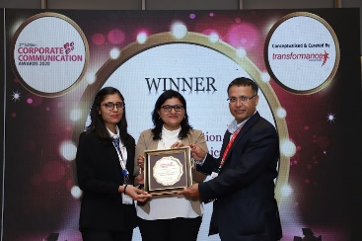
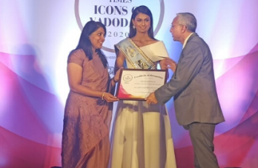
Raising Brand of Asia, 2019
Certificate of Merit
India’s most trusted Companies
Award, 2019
Fortune Next 500
Deepak Nitrite Limited, ranks 74th in Fortune 500 Next list, 2019 by Fortune Magazine. Recognized as top wealth creator in mid-size category.
Deepak Group was conferred with prestigious
Raising Brand of Asia, 2019 by BARC Asia under Global Business Symposium.
Deepak Nitrite Limited was conferred with India’s Most Trusted Companies Award by IBC
AWARDS
National Best Employer Award,
2018
Transformance Award, 2020
Times Icon of Vadodara, 2020
Deepak Nitrite Limited conferred with National Best Employer Brand 2018 by Global Employer Branding Instituite
Deepak Nitrite Limited (DNL) was conferred with Best Innovation in Digital Communication by Transformance forums for its digital campaigns and social media initiatives
Deepak Nitrite Limited (DNL) was conferred with “Best Chemical Intermediates Company- Times Icon of Vadodara” award by Times Internet Limited- A division of Times of India.
27

Slide 28
5 Pillars Of Human Resources
Committed to be an Equal Opportunities Employer
9.2 Years average employee tenure
Management Development Programs for high potential employees arranged at prestigious management institutes since 2014
Merit-based reward system, work-life balance and at par fringe benefits across all levels
Assessment and development centers for the leadership team
Career
Life
HUMAN
RESOURCES
Health
Skill Development
Employee Engagement
28
28

Slide 29
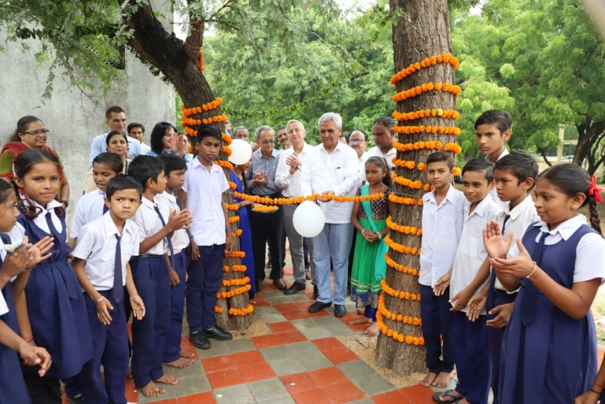
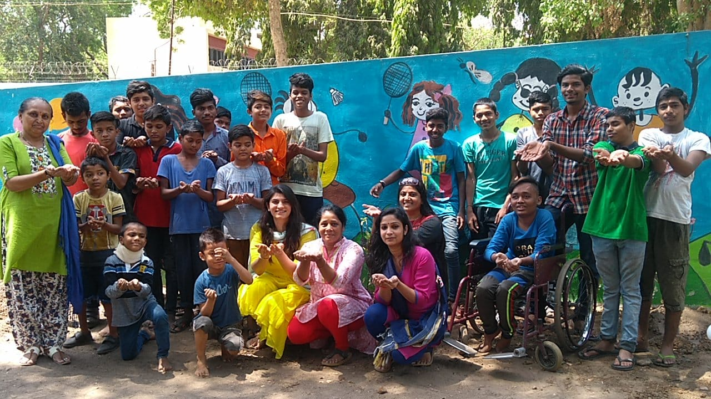
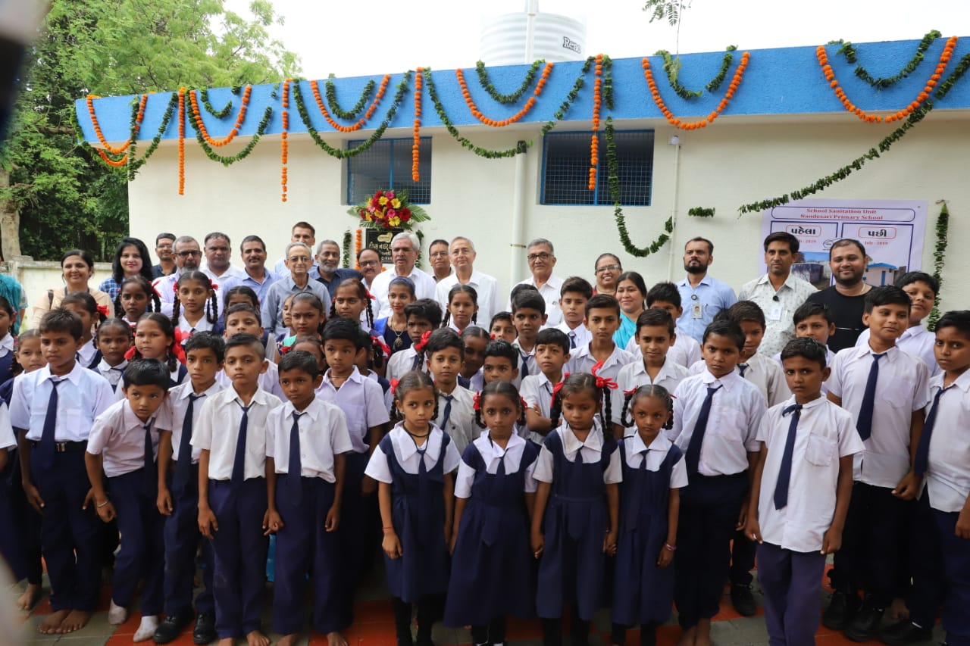
CORPORATE
SOCIAL
RESPONSIBILITY
29

Slide 30
40+ years I 2 million people
- Maternal and neonatal care
- Livelihood projects
Some of the key initiatives include:
DEEPAK FOUNDATION
EDUCATION:
MEDICAL INITIATIVES:
Integrated child development services
Occupational health services in GIDC
Mobile library
Quality care in tribal areas
Wage employment trainings
Healthcare at doorstep
Medical intervention & services
De-addiction & counselling services
LIVELIHOOD
Blood donation camp
Water harvesting
30

Slide 31
Beneficiaries in urban, rural and tribal areas | 171387
Marginalized people reached through doorstep healthcare services | 48731
Rural women empowered through entrepreneurial support | 1840
Youth skilled in health sector trained in the rural areas | 240
Children monitored for food intake | 9035
Children facilitated for enhancing reading & comprehension skills | 3068
Beneficiaries reached for deaddiction & counselling services | 25440
Children with special needs supported | 247
Tribal women supported through quality maternal & child health services | 71109
Deliveries conducted annually in tribal areas | 4324
Facilitating 24*7 emergency help desk services at district hospital, Vadodara | 34497
DEEPAK FOUNDATION
31

Slide 32
Aaditya – I & Aditya - II, Chhani Road, Vadodara - 390024. Gujarat, India.
Tel: +91 265 276 5200/396 0200 | Fax: +91 265 276 5344
www.godeepak.com
Investor Relations | investor@godeepak.com
Customer Query- DNL | customer.dnl@godeepak.com
Careers | hr@godeepak.com humanresources@godeepak.com
Segments- DNL | bcc@godeepak.com, fns@godeepak.com, oba@godeepak.com
DPL | customer.dpl@godeepak.com
Other | info@godeepak.com
CONTACT
INFORMATION
32

